Slide 1
Retailware Softech
SEO Audit
By Mohamed Askaf

Slide 2
SEO Audit Report for Retailware softech
Purpose of the Audit: Identifying and addressing SEO issues, implementing best practices, and improving the site's visibility and ranking on search engines.
Audit Date: 20/08/2024
Website Overview Website URL: https://retailware.in/ Industry/Niche: Software development for Retailers

Slide 3
Keyword Research
Head Keyword: retail software
Body Keyword: billing software for retail shop retail billing software retail invoicing software retail store billing software retail inventory management
Longtail Keyword: affordable retail shop billing software for small businesses retail store billing software with advanced inventory management features customizable retail billing software with inventory management features best retail invoicing software for tracking sales and expenses retail inventory management software with real-time stock tracking

Slide 4
On-Page SEO Report
URL: https://retailware.in/
Title: Retailware Softech Pvt Ltd (26 characters)
Meta Description : Null
H1: Purely Retail Focussed Company
H2:
Keyword Analysis: The most common keyword is "store" with a count of 31, followed by "retailware" and "contact" with a count of 5 each. Other keywords include "center," "wear," "food," "client," "home," "retail," and "mobile."
Link Analysis: The page contains a total of 99 links, out of which 29 are unique. Among these, 24 are internal links, while 5 are external. Notably, all 29 unique links lack a title attribute.
Image Optimization:
About Us
Our Partners
75 Images
68 Without Alt text
75 Without Title

Slide 5
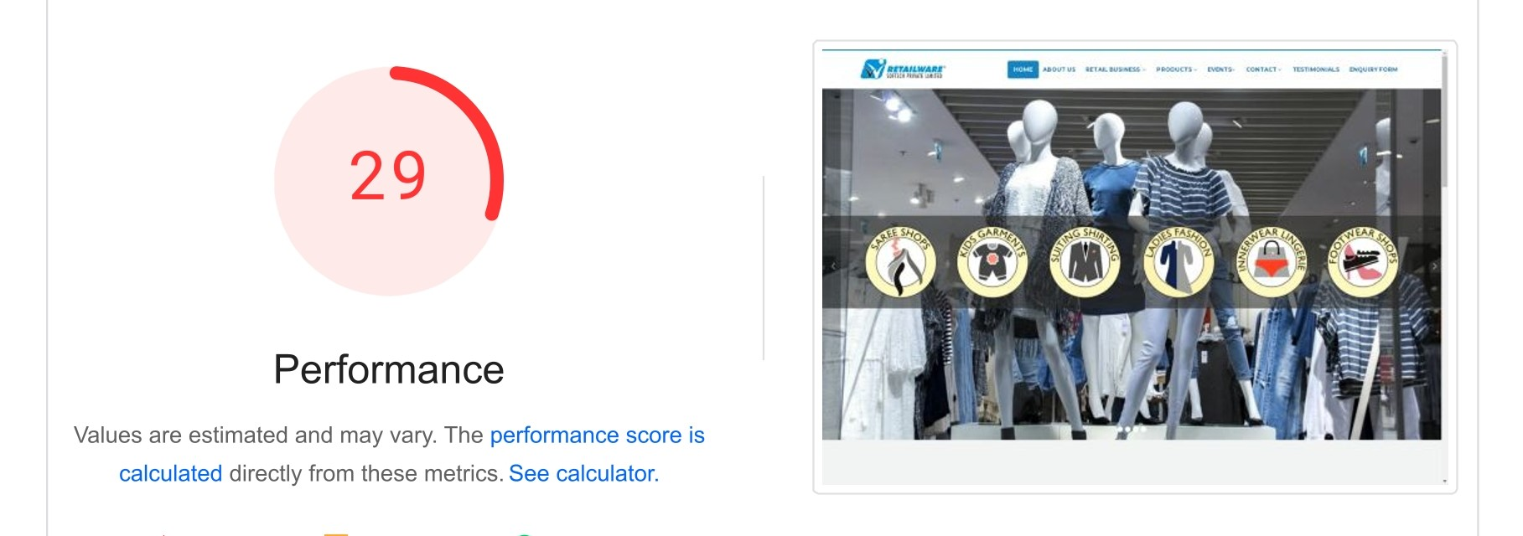
Technical SEO Report
Google PageSpeed Report
Overall Performance Scores Mobile Performance Score: 27/100 Desktop Performance Score: 29/100
Key Metric Analysis
Metric | Mobile Value | Desktop Value | Ideal Value
First Contentful Paint (FCP) | 4.4s | 1.0s | < 1.8s
Speed Index (SI) | 14.9s | 4.5s | < 3.4s
Largest Contentful Paint (LCP | 11.9s | 2.2s | < 2.5s
Total Blocking Time (TBT) | 4970ms | 830 ms | < 200ms
Cumulative Layout Shift (CLS) | 0 | 0.559 | < 0.1

Slide 6
On-Page SEO Report
URL: https://retailware.in/retailware
Title: Retailware Softech Pvt Ltd (26 characters)
Meta Description : Null
H1: Null
H2:
Keyword Analysis: The most common keyword is "store" with a count of 31, followed by "retailware" with a count of 6 and "center" with a count of 5. Other keywords include "wear" (5), "food" (5), "home" (4), "contact" (4), "products" (2), "supermarket" (2), and "mobile" (2).
Link Analysis: The page contains a total of 99 links, out of which 29 are unique. Among these, 24 are internal links, while 5 are external. Notably, all 29 unique links lack a title attribute.
Image Optimization:
Retailware
75 Images
68 Without Alt text
75 Without Title

Slide 7
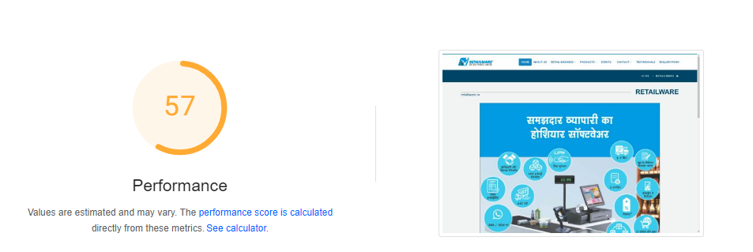
Technical SEO Report
Google PageSpeed Report
Overall Performance Scores Mobile Performance Score: 22/100 Desktop Performance Score: 57/100
Key Metric Analysis
Metric | Mobile Value | Desktop Value | Ideal Value
First Contentful Paint (FCP) | 4.0s | 0.9s | < 1.8s
Speed Index (SI) | 8.9s | 2.5s | < 3.4s
Largest Contentful Paint (LCP | 6.5s | 1.2s | < 2.5s
Total Blocking Time (TBT) | 1840 ms | 320 ms | < 200ms
Cumulative Layout Shift (CLS) | 0.299 | 0.446 | < 0.1

Slide 8
On-Page SEO Report
URL: https://retailware.in/events
Title: Retailware Softech Pvt Ltd (26 characters)
Meta Description : Null
H1: Null
H2: 11 Tags
Keyword Analysis: The most common keyword is "store" with a count of 31, followed by "knowledge," "series," "date," "time," "registration," and "link," each with a count of 11.
Link Analysis: The page contains a total of 99 links, out of which 29 are unique. Among these, 24 are internal links, while 5 are external. Notably, all 29 unique links lack a title attribute.
Image Optimization:
75 Images
68 Without Alt text
75 Without Title

Slide 9
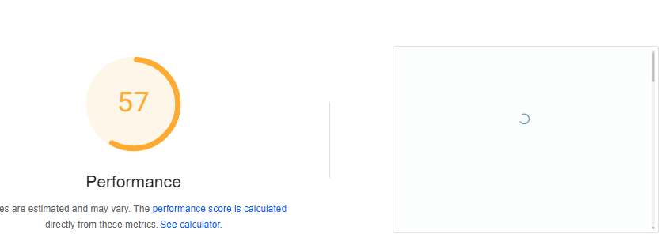
Technical SEO Report
Google PageSpeed Report
Overall Performance Scores Mobile Performance Score: 35/100 Desktop Performance Score: 57/100
Key Metric Analysis
Metric | Mobile Value | Desktop Value | Ideal Value
First Contentful Paint (FCP) | 4.1s | 1.0s | < 1.8s
Speed Index (SI) | 40.6s | 9.2s | < 3.4s
Largest Contentful Paint (LCP | 4.7s | 1.1s | < 2.5s
Total Blocking Time (TBT) | 319010 ms | 5900 ms | < 200ms
Cumulative Layout Shift (CLS) | 0 | 0.003 | < 0.1

Slide 10
Technical SEO Elements
HTTPS | Yes
URL Indexed | Yes
Redirect 200 (www) | Null
Robots Txt file | Null
Sitemap XML file | Null
Custom 404 Page | Yes
Canonical Tag | Null
Meta Robots Tag | NUll
Schema Markup | Null

Slide 11
On-Page SEO Recommendation
Update the title to "RetailWare Softech: Custom Retail Software Solutions" (53 characters) for better search engine visibility.
Add clear and concise meta descriptions to attract more clicks from search results.
Ensure the Page Title and H1 tag are aligned for improved relevance.
Organize header tags (H2, H3, etc.) in a clear hierarchy for better content structure.
Reduce the number of internal links on the page to avoid overwhelming users and search engines.
Properly name files and add alt text to images to enhance SEO and accessibility.

Slide 12
Technical SEO Recommendation
Compress your images and use the minimum number necessary. This helps reduce load times and enhances the user experience. Also, limit the use of embedded YouTube videos to just one per page to avoid slowing down your site. These changes can make your site faster and more efficient.
Cutting down on unused CSS and JavaScript makes your web pages load faster. It reduces the amount of data that browsers have to download, read, and run, which makes the page render more quickly. This also saves on bandwidth and lowers server costs. Faster, simpler code improves how well caching works.
Host fonts and frameworks like Bootstrap locally or in your root directory. This practice helps reduce render-blocking issues and minimizes unnecessary third-party payloads, leading to faster page loads and a more streamlined user experience.
To simplify and speed up your website's tracking, use a tag manager to combine all your tracking codes into a single snippet.
To avoid issues with duplicate content, implement canonical tags on your pages to indicate the preferred version. Additionally, set up redirects for variations like "www," "/index," and other different URLs to point to a single, consistent URL. This helps consolidate your site's authority and ensures that search engines recognize your primary page version, enhancing your site's overall SEO performance.
This method to enhance your site's visibility and SEO utilizes a "sitemap.xml" file to help search engines discover and index your pages more efficiently. Additionally, implement schema markup to provide structured data that enhances how your content appears in search results.

Slide 13
Content Strategy
Suggested blog title : How to Choose the Best Billing Software for Your Retail Shop The Benefits of Using Billing Software in Retail Shops Why Every Retail Shop Needs Efficient Billing Software How Billing Software Can Improve Customer Experience in Retail Shops Choosing the Right Billing Software for Your Retail Store: A Step-by-Step Guide Why Every Retail Store Needs Modern Billing Software
Suggested Article title : The Ultimate Guide to Retail Billing Software for Small Businesses Top 5 Retail Billing Software Options for Small Businesses in 2024 How Retail Store Billing Software Can Boost Your Business Efficiency
Whether using blog posts, articles, videos, or infographics, start by creating a content calendar to organize and maintain a consistent publishing schedule. Focus on producing high-quality, valuable content that addresses audience needs or provides solutions. Use SEO best practices to optimize content for better search engine visibility. Regularly analyze website analytics to track performance and make data-driven adjustments to keep your strategy effective and aligned with audience preferences

Slide 14
Off-Page SEO
Domain Authority: 14 Page Authority: 27
Social Platform: Youtube Name: Retailware Softech Pvt Ltd. URL: https://www.youtube.com/@retailware/
Recommendation
Building backlinks involves getting other websites to link to yours, which helps increase your domain authority (DA) and page authority (PA). Start by creating valuable and unique content that people want to share.
YouTube for off-page SEO can significantly enhance your website's visibility and brand recognition by creating high-quality, engaging videos that attract shares and backlinks.
Influencer outreach involves collaborating with industry influencers to promote your brand and content, increasing exposure and earning high-quality backlinks. Building genuine relationships with relevant influencers can amplify your reach and boost your off-page SEO efforts.

Slide 15
Thankyou

